Slide 1

Boosting Sales for a Supermarket
Ayden Projain

Slide 2
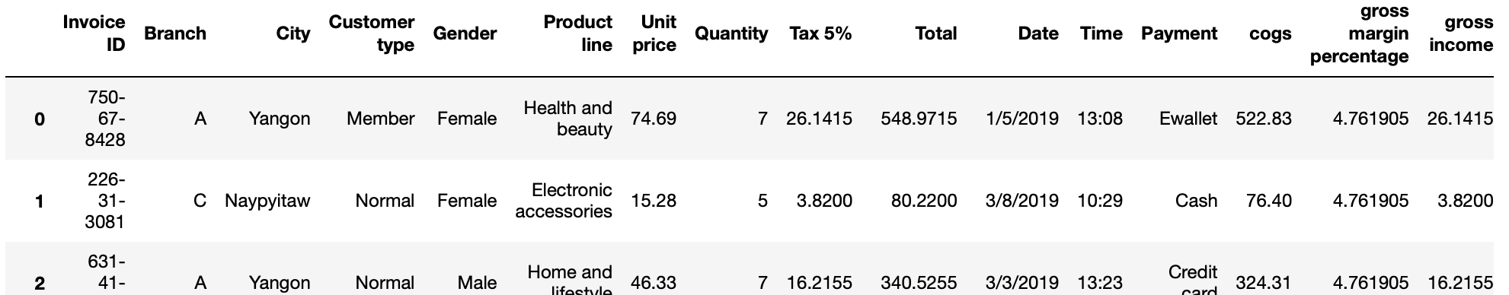
Why I chose this dataset
Wanted to find data correlations or disproportions
Try to boost sales for a company through data
Supermarket had many variables

Slide 3
Problems I overcame
Finding correlations and issues to solves
Many data columns to compare

Slide 4
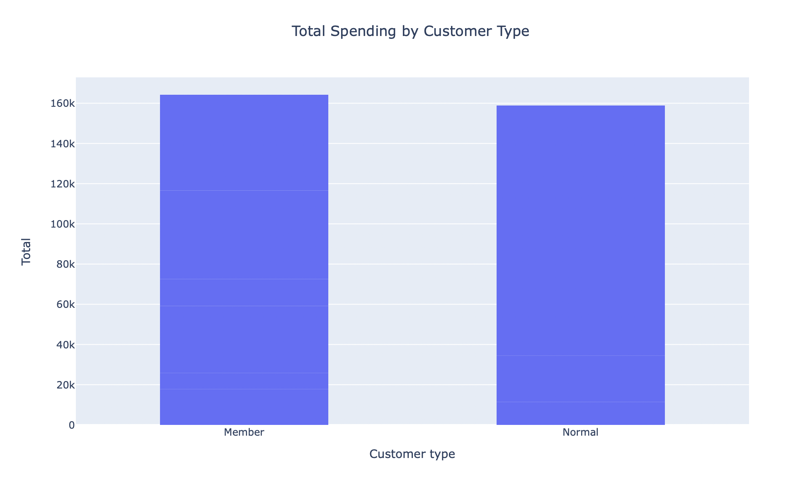
Customer type
Group of customers that switched over to a membership spent more in total over three months

Slide 5
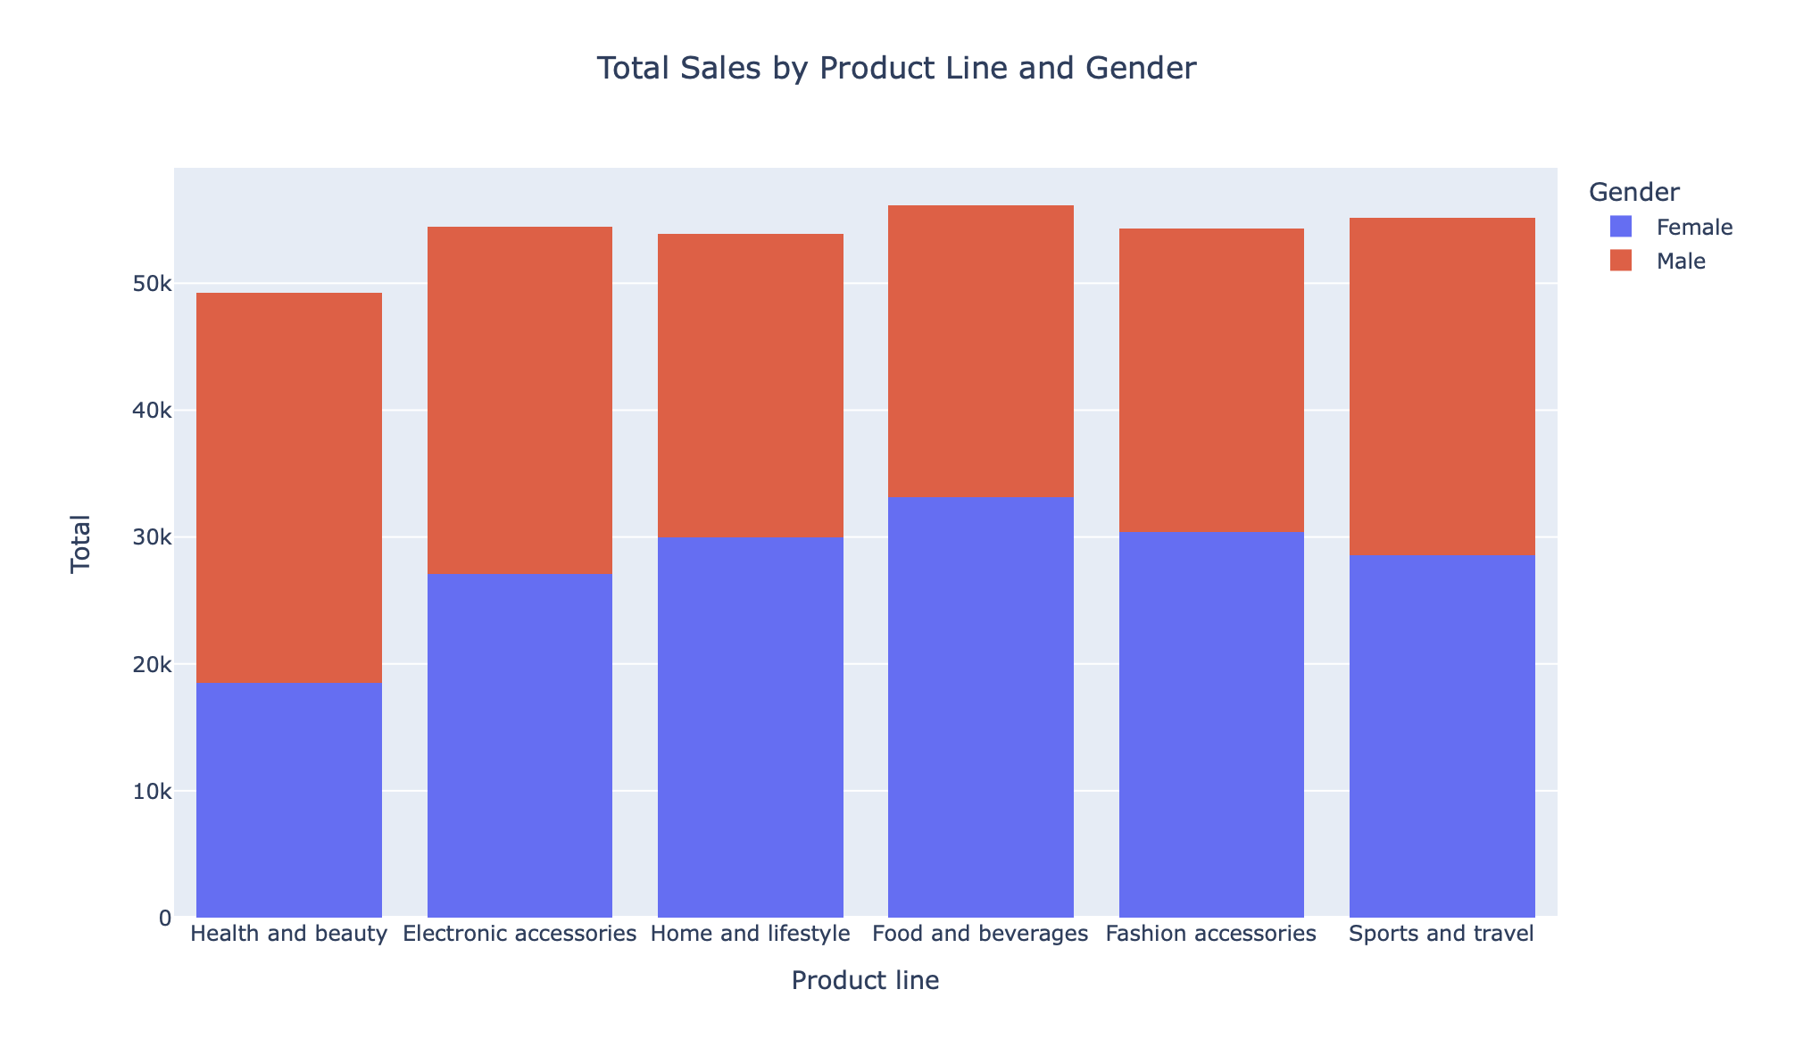
Data disproportion
Females purchasing far more than males on other products like fashion accessories and food. However, their purchases dropped for health and beauty.

Slide 6
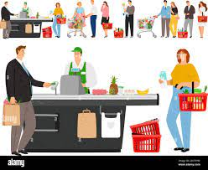
Marketing solutions
Focus on getting customers to switch to a membership
Market health and beauty products target to female consumers to make up for this disproportion

Slide 7
Improvements
Look for more meaningful correlations with more explanations
More elaborate data analysis and visuals
Machine learning

Slide 8
Thank you

